Slide 1
Tableau Assignment - 1
File created on: 8/2/2021 7:25:46 AM

Slide 2
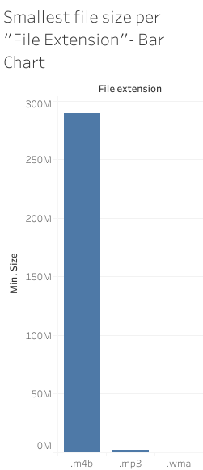

Slide 3
